Slide 1
2012-13 Calendar Development Survey Results
Survey Start Date: June 30, 2011
Survey End Date: July 11, 2011
Total Responses: 2,840

Slide 2
Survey Respondents

Slide 3
Overall Calendar Rankings

Slide 4
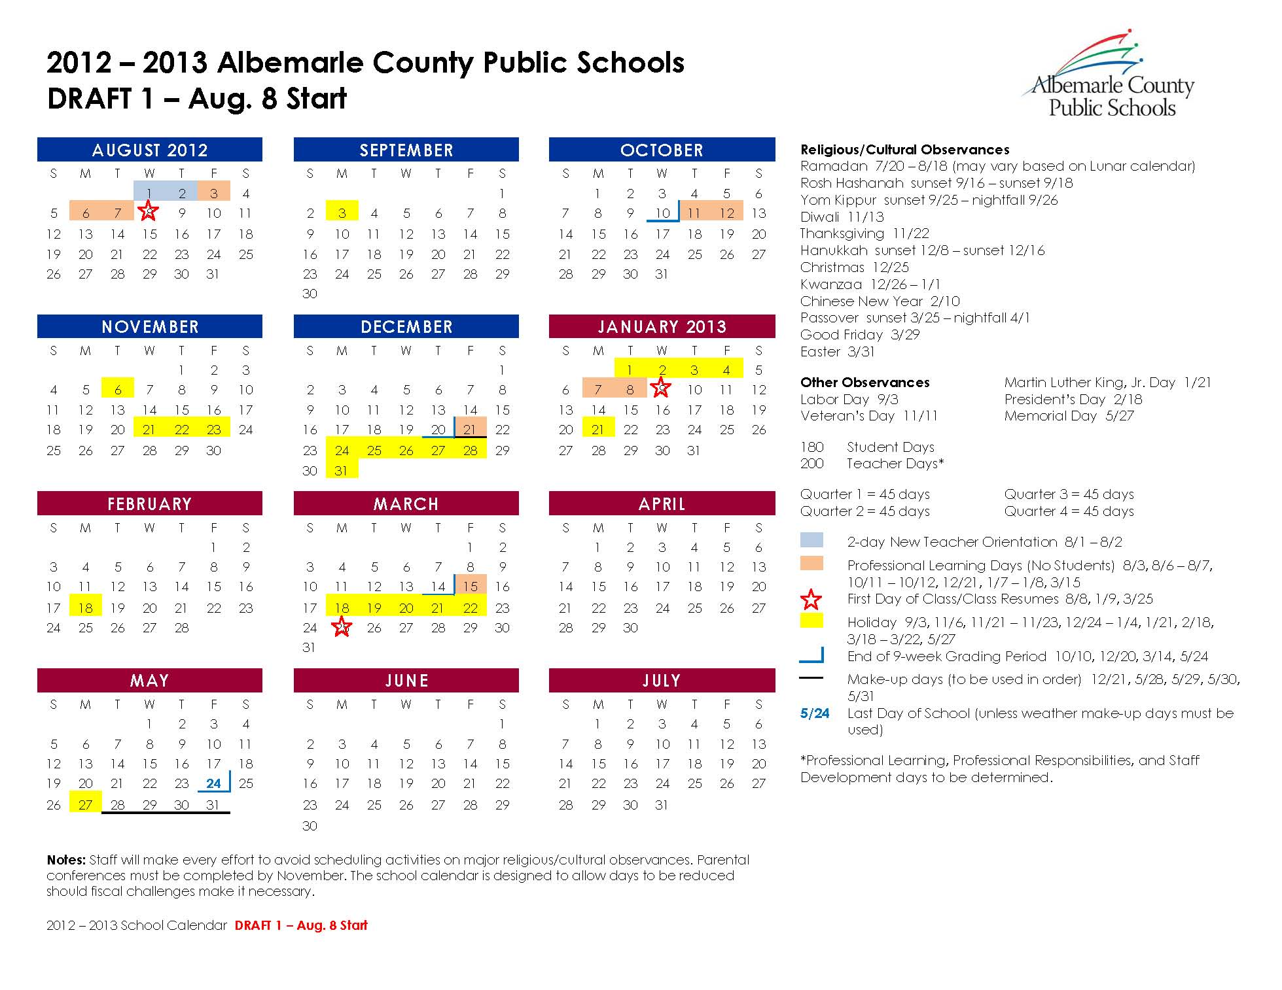

Slide 5
Draft 1 - Aug. 8 Start
Common Likes | Common Dislikes
Full day off before Thanksgiving | Early start interferes with summer camps, sports and enrichment activities; teen employment; family vacations; and professional development opportunities for teachers
High school exams prior to Winter Break | Concern about effect of extreme heat on school cooling costs, long rides on buses without AC, and instructional time
Equal number of days in each quarter | Too few teacher work days before start of school; no teacher work day after last quarter
Teacher work day following each quarter | Winter break too long: Difficult for working parents and disruptive to learning
Pre-Memorial Day dismissal | Misalignment with other area school and preschool schedules

Slide 6
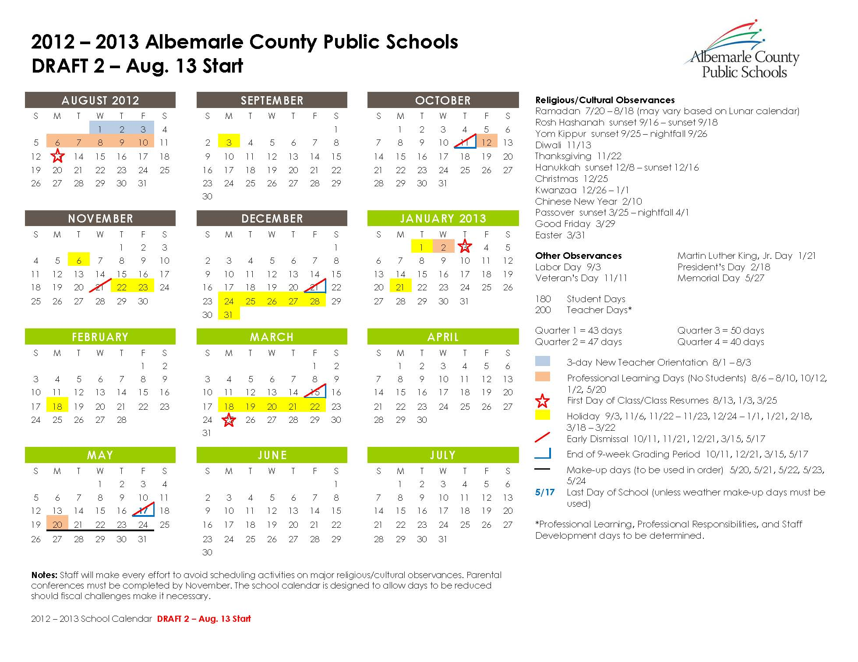

Slide 7
Draft 2 - Aug. 13 Start
Common Likes | Common Dislikes
High school exams prior to Winter Break | Half-day before Thanksgiving
More “New Teacher” days prior to start of school | Half-days in general: Difficult for working parents, high absentee rate, and ineffective use of instructional time and resources
Some teachers favored the use of half days for much needed PLC time | No teacher work day after Quarter 3
 | Mid-May dismissal: Area childcare and camp schedules are not active until June
 | Varied number of days in each quarter; not enough days in Quarter 4
 | Misalignment with other area school and preschool schedules

Slide 8
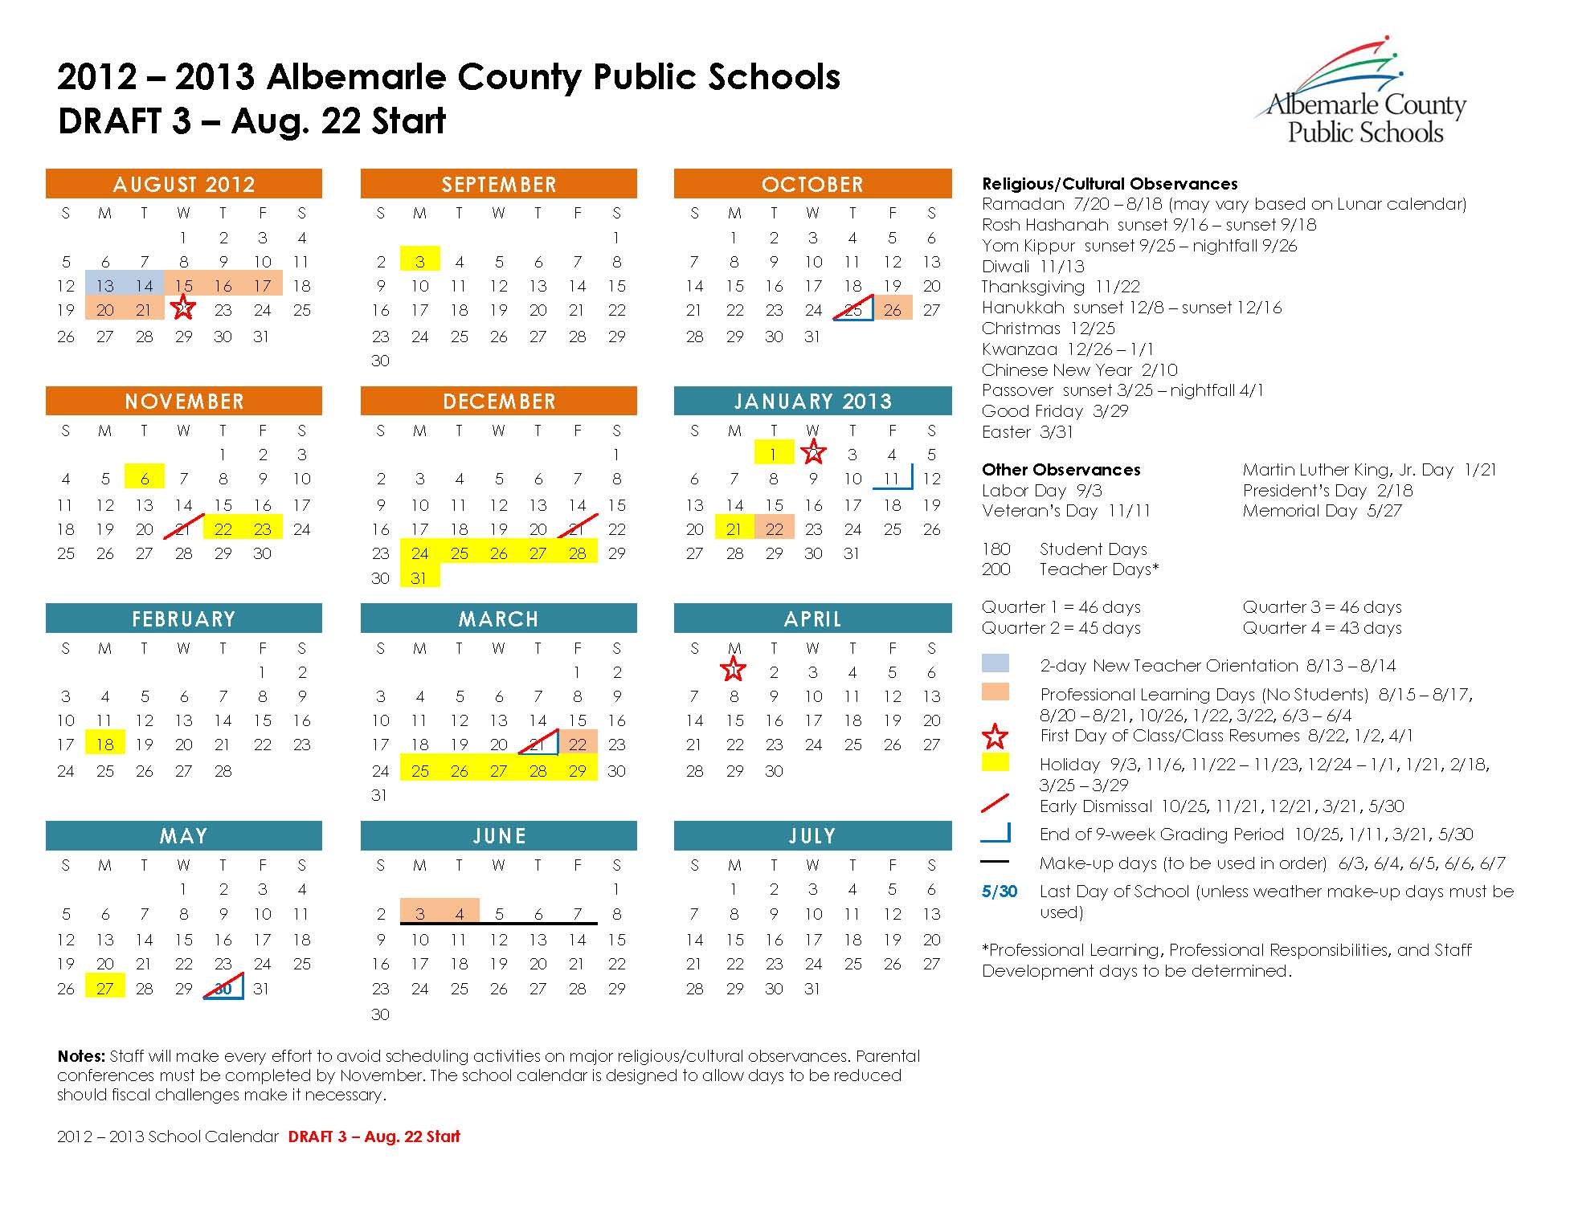

Slide 9
Draft 3 - Aug. 22 Start
Common Likes | Common Dislikes
Commonality with other area school and preschool schedules | Half-day before Thanksgiving
Mid-week start date | Half-days in general: Difficult for working parents, high absentee rate, and ineffective use of instructional time and resources
Some teachers favored the use of half days for much needed PLC time | Ending the first semester after Winter Break
NOTE: There was some confusion about why May 31 was not allocated as a professional learning day/make-up day.

Slide 10
Other Common Themes
Rationale requested for considering an earlier start date
Many comments favoring post Labor Day start
Several teachers commented about the need for a teacher work day following each 9-week quarter
Desire to keep Spring Break the first full week in April, as in the past
How will differing schedules between ACPS and CCS affect CATEC? How will differing schedules between ACPS and area colleges affect high school seniors who want to take college courses?
No day reserved for parent/teacher conferences: Are conferences expected to take place only in the evenings?
Continued on next slide …

Slide 11
Other Common Themes (Cont’d)
Winter Break: Lots of support (especially from teachers) for a traditional 2-week break; almost as much support for a slightly shorter break
Several comments favoring May dismissal as a means to minimize unproductive instructional time following SOL testing
Consider building in inclement weather days rather than tacking them onto the end of the school year
Consider phasing in an earlier start date over the course of two years
Consider shorter summers and longer school year breaks to limit academic disruption; several mentions of year-round school
Several comments suggesting an amalgamation of the three drafts

